Slide 1
Chapter 9
Momentum and the Conservation of Momentum
Linear Impulse and Momentum
Impulse-Momentum Theorem and Conservation of Momentum
N-II Law for the Motion of the Center of Mass
Systems of Variable Mass

Slide 2
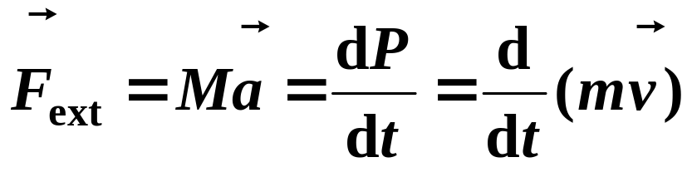
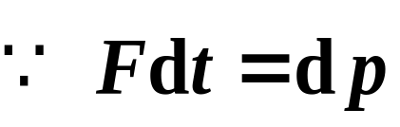
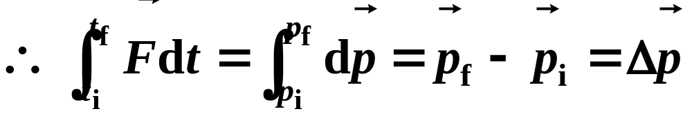
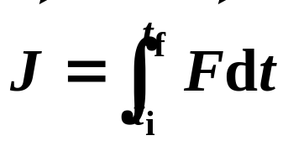
9-1 Linear Impulse-Momentum Theorem
1. Impulse-momentum theorem
研究力和运动的时间积累过程关系。
❒
❒
p
=
m
v
—– momentum (动量)
—– the impulse(冲量)of force

Slide 3
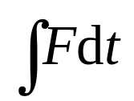


❒
❒
❒
❒
J
=
Δ
p
=
p
−
p
impulse-momentum theorem
f
i
Net linear impulse delivered to a particle equals the change in linear momentum of the particle (物体在运动过程中所受合外力的冲量，等于该物体动量的增量).
Descriptions:
(1) F should be the sum of all external forces. When the force is constant, the direction of J is as same as the force; if F is variable, the direction of J is determined by the integral of .
(2) Both and are vectors. They have same units and dimensions. This theorem is only hold for IRF.

Slide 4
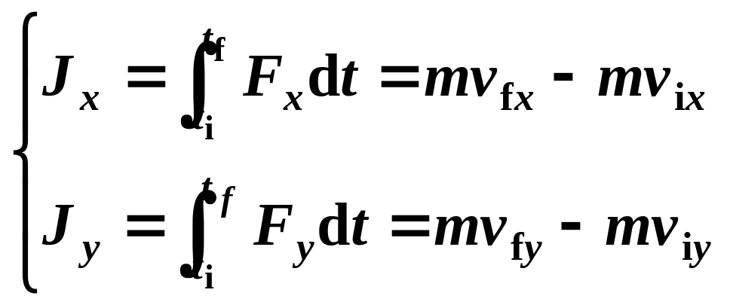
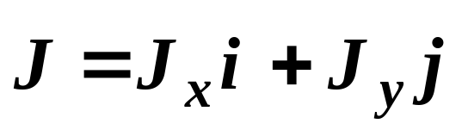
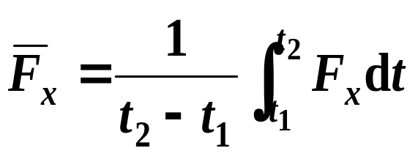

(3) In reality, one often use its component form:
(4) The magnitude of the impulse is equal to the area under the F(t) curve.
Fx
/ N
O
t1
t2
t
/s
Look at Problem 28 of P227!!!

Slide 5
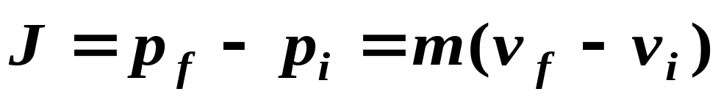
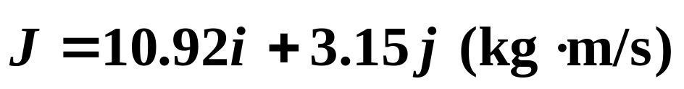
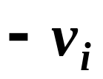

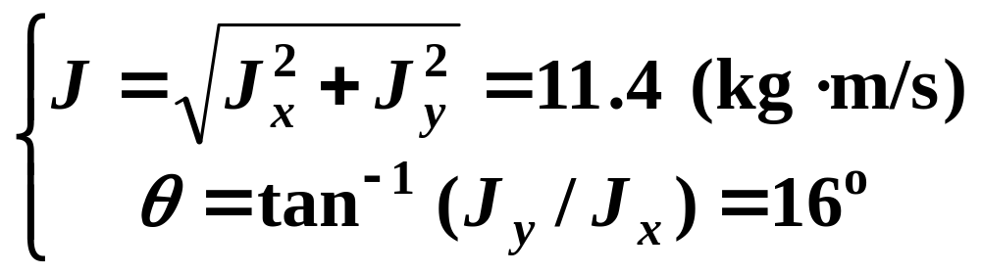


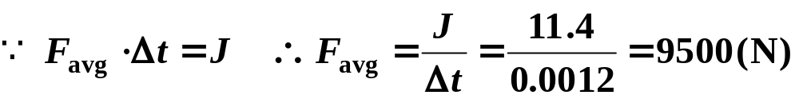
EXAMPLE:
A pitched 140g baseball, in horizontal flight with a speed of 39m/s, is struck by a bat and the ball leaves the bat with a speed of 45m/s, at an upward angle上偏 of 30º (a) what impulse act on the ball? (b) If the impact time is 1.2ms, what average force act on the baseball.
Solution:
(a)
y
o
30º
x
(b)
Discussion:
Comparing the F_{avg} with the F_{ext}.

Slide 6


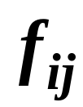


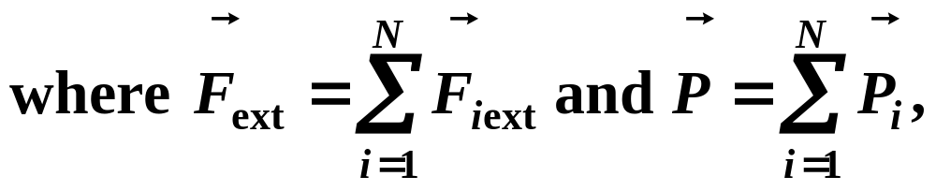
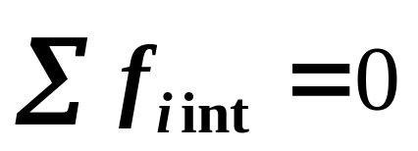
9-2 Conservation of Momentum (P202)
Momentum theorem of particle system
There are N particles in a system. The equation of motion for particle i is,
❒
i
❒
❒
d
p
F
+
f
=
i
iext
i
int
d
t
for the whole system is,
j
N
❒
N
❒
∑
d
p
d
∑
p
❒
❒
i
i
∑
F
+
∑
f
=
i
=
1
=
i
=
1
i
ext
i
int
d
t
d
t
note

Slide 7
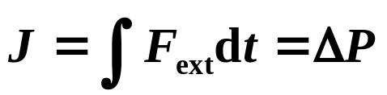
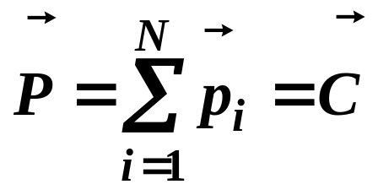
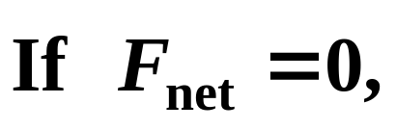
—– impulse-momentum theorem of particle system
The impulse of external forces acting on a system = the change of momentum of the entire system.
conservation of momentum
then
If no net external force acts on a particles’ system, total linear momentum of the system cannot change.
No exceptions to this law have been discovered. So it is considered to be more fundamental than Newton’s second law in both macroscopic and microscopic physical worlds.

Slide 8
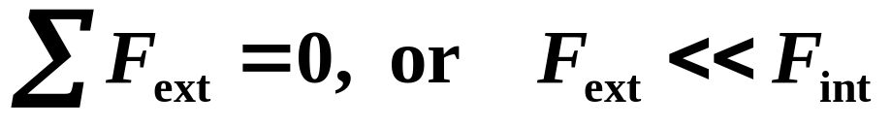
Explanations:
(1) Conditions of validity:
Net forces can be neglected in the case of collision, strike, explosion, … ,and so on.
(2) Conclusion: Only external force can change the state of motion of a system.
(3) If component of net external force on a system along an axis is zero, the component of momentum of the system along that axis does not change.
(4) It is only suitable for inertial reference frame.

Slide 9
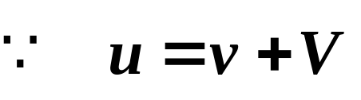


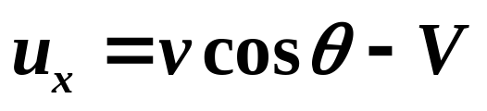



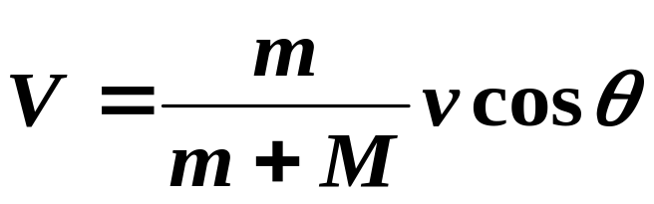
Example:
A gun mounted on wheels of mass M shoots a projectile of mass m with muzzle (出口) velocity of v (对炮车)at an angle θ above the horizontal. Find the horizontal recoil (反冲) speed V of the gun (求：炮车反冲速度V). (neglect friction)
Solution:
m
M
The recoil speed:
x

Slide 10
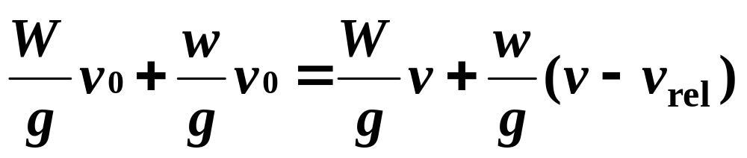
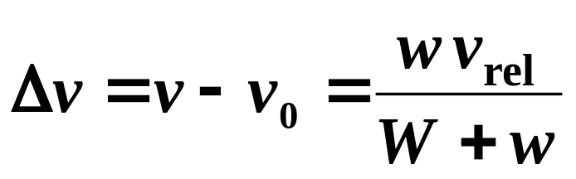

Example:
A flatcar of weight W can roll without friction along a horizontal straight track. Initially, a man of weight w is standing on the car, which is moving to the left with speed v_{o}. What is the change in velocity of the car if the man runs to right so that his speed relative to the car is v_{rel}.
Answer:
v_{rel}
The direction of it is as same as the one of v_{rel.}
w
v_{o}
W

Slide 11
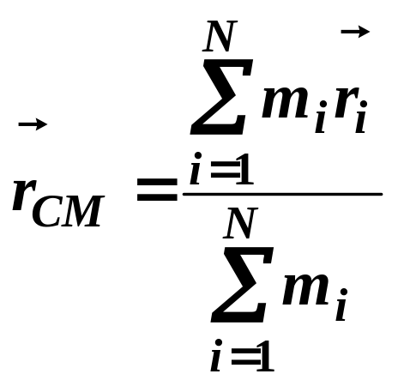

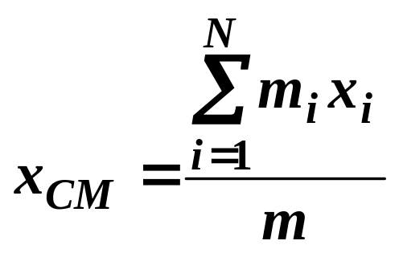
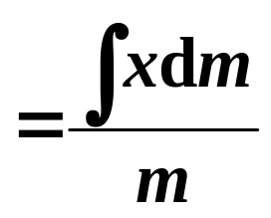

9-3 The Center of Mass
The center of mass of N-particle system is a point that moves as though all of mass were concentra-ted there and all external forces were applied there.
Define the position of the center of mass (CM) of N-particle system to be:
z
m_{i}
y
x
Similar relations to the y and z components.

Slide 12
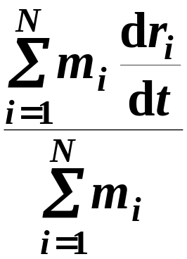
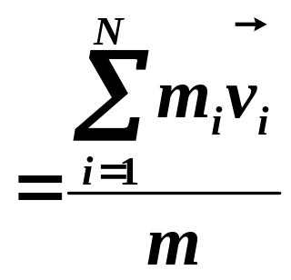
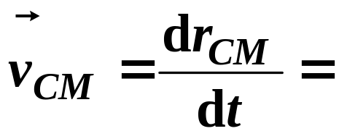
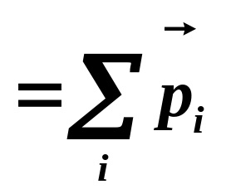
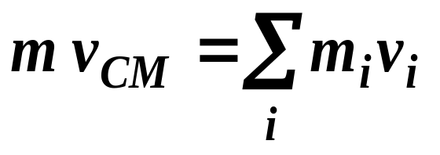
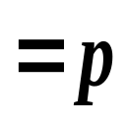
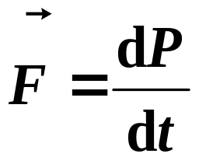
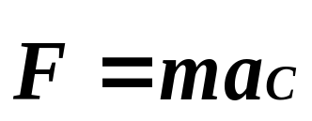

N-II Law for the motion of the center of mass:
质点系的总动量==它的总质量与其质心运动速度的乘积。
质心运动定理
The sum of all forces acting on a system = total mass of the system times of its center of mass.
If a particle system exerted by zero force, the velocity of mass center keep constant.

Slide 13
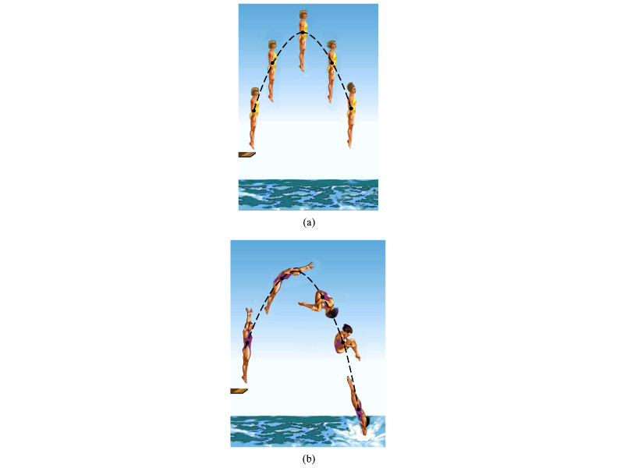
The center of mass of all parts of the bodies moves like a single particle acted by the same net external force ——gravity.

Slide 14
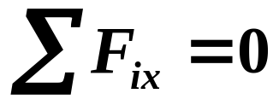
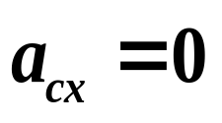
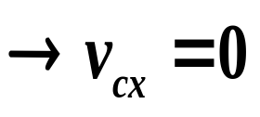
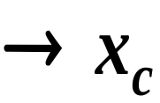
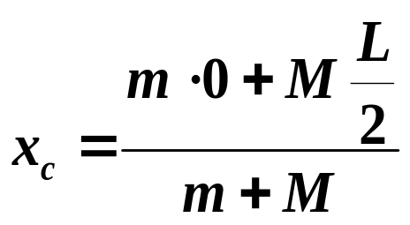
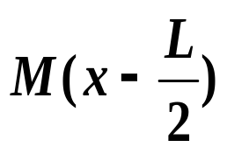
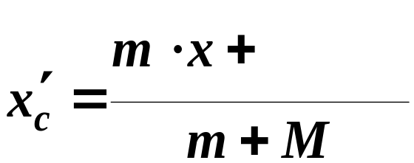
Example:
As figure shown, a boat L=4m, M=150kg. It is initially rest on the water. When a men, m=50kg, walks from the head to the tail of the boat, what are the distances of the men and boat relative to the beach, respectively (人和船对岸各移动的距离)neglect the friction from water.
质心初始静止
Solution:
The way:
1.
y
=constant
L
.
Initial:
x
Final:
x
X

Slide 15
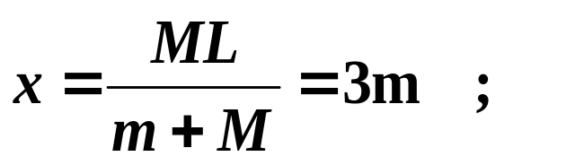




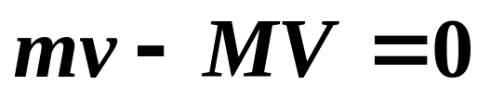
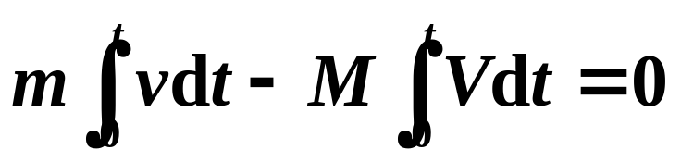

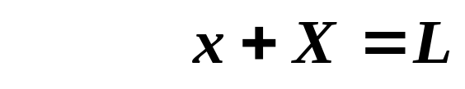
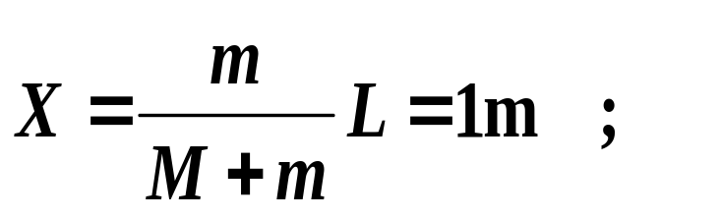

Solution:
The way:
2.
y
Let and denote the velocity of boat and men relative to the beach at any instant, then
L
V
.
x
x
X

Slide 16
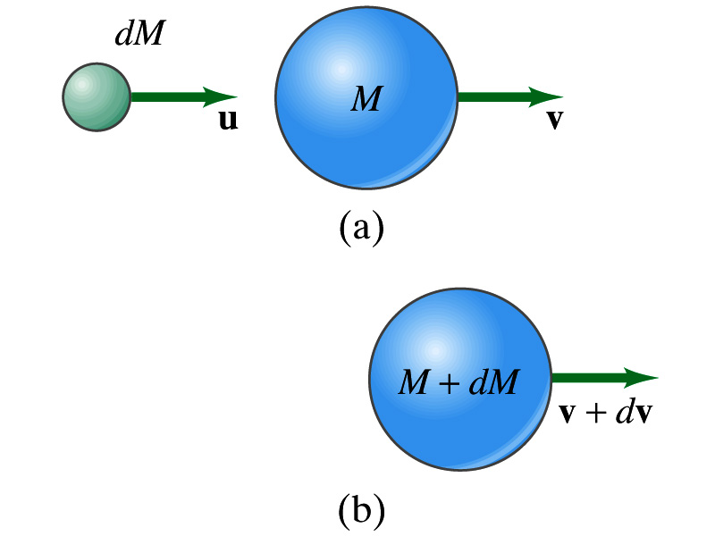




9-4 Systems of Variable Mass: Rocket Propulsion
As Fig. 9-33 shown, a system has changed in mass from M to M+dM in time dt, we have
With a little algebra and note,
Then a dynamic equation for this system should be:

Slide 17

Where, the two terms on its right side represents the sum of external force on the mass M and the force exerted on it due to the addition of mass.
For a rocket propulsion,
—— The thrust (推力) of the rocket engine.
It depends on the design characteristics of a rocket engine —— the rate at which it consumes fuel mass and the speed v_{rel.}with which that mass is ejected relative to the rocket.
Look at examples in §9-10 after class.

Slide 18
The problems of chapter 9:
5, 12, 13, 17, 19, 28, 29, 42, 75, 83, 85, 105

